Slide 1
Big Table Group
Digital Workspace
Notes:
Brett

Slide 2
Contents
01
02
03
04
Project overview
Scope
Wireframes
Next steps
Why are we doing this?
Objective
Desired outcomes
Approach
Proposed solution
Scope
Release schedule
Solution structure
Home Page
People Finder
Knowledge Hub
Next steps
Activities to be completed
Notes:
Brett

Slide 3
Project Overview
One Digital Workspace
Why are we doing this?
Objective
Desired outcomes
The Big Table Group (BTG) is a growing and evolving business and the Digital Workspace needs to respond to this growth.
The existing solution is outdated and ineffective for the business needs, in addition, information is scattered across multiple platforms which are often neglected, out of date and difficult to access.
By developing a new Digital Workspace we are creating easier pathways into knowledge, communications and applications, improving productivity, reducing operational costs and strengthening staff knowledge.
To create a Digital Workspace platform bespoke to BTG that becomes a natural part of peoples working lives. The platform will allow unobstructed and seamless access to communications, knowledge and work systems, enabling self-service and increased efficiency.
The Digital Workspace will be a platform that:
Directs people to communications, knowledge and systems they use each day
Provides a portal to knowledge and communications
Generate efficiencies in the way that BTG employees work
Searches and recalls information quickly and efficiently
To gain efficiencies with everyday tasks
Improve productivity
Integrates with existing systems (eg. Workplace)
Minimal inhouse IT support and maintenance
Minimise knowledge duplication
Lower operation costs with less time spent on manual tasks and offline processes
Increased collaboration across the business
An adaptive user interface and experience.
To protect and share business knowledge
Increased collaboration across the business
Notes:
Brett

Slide 4
Project Approach
One Digital Workspace
Discovery
Design
Develop
Deploy and Implement
Phase one
Phase two
Phase three
Phase four
Requirements gathering activity to define and validate the scope of the solution.
Hi-fidelity design, prototyping the proposed solution for validation through testing.
Development, though planned sprints with client product demonstrations.
Deployment to the The Big Table Group technical environment, validating through testing.
Notes:
Brett

Slide 5
Scope
Big Table Group

Slide 6
Proposed Solution
One Digital Workspace
Proposed solution
Scope
Release schedule
A solution that will make it easier to find information, and collaborate with colleagues whilst improving productivity and strengthening team knowledge.
We will deliver a solution that addresses the following challenges:
Connection and Communication
Collaboration and teamwork
Application accessibility
Organisational knowledge
Finding people information
Ease of access to brand information
Ensuring:
a positive user experience that doesn't comprise usability overlook and feel
the solution is engaging and visually pleasing, consistent with the The Big Table Group brand
integrations with existing systems, including: Workplace and Office 365
the solutions is mobile enabled for users to access content remotely.
The scope of this project is to support the The Big Table Group team by bringing your digital landscape together with One Digital Workspace.
We propose a phased build and release to address the business requirements.
Release One
Home Page
People Finder
Knowledge Hub
Collaboration Sites
Brand Pages
About BTG Page
Release Two
Brand Specific Operational Sub-Sites
Release One
Wave One
Home Page
People Finder
Wave Two
Brand Pages
Collaboration Sites
Wave Three
Knowledge Hub
Release Two
Brand Specific Operational Sub-Sites

Slide 7
Releases One and Two Scope
One Digital Workspace
Release One Scope
Release Two
Home Page
Global Newsfeed – Integration with Workplace BTG News Group
Global Quicklinks
Teams Activity Feed – Integration with Teams activity and start new teams chat
BTG People – Latest Searched People
My Favourites
To Do List Integration
My Calendar
Brand Navigator
Promotion of brand pages
Knowledge Hub
Brand (BTG, BI, LI, CR, TM)
Operational Area
Content Type (Policy, Procedure, Template, Guide)
People Finder
Ability to search and filter people
Access to global employees' profiles and contact details, linked with Microsoft profile in Delve
Who’s Who Description
Brand Pages
About BTG – Mission, Vision, Brands
Brand news feed BI, LI, CR, TM – Workplace from Facebook
About Brand, Brand Director and Team
Brand Related Quicklinks and Knowledge
Collaboration Sites
Collaboration Sites are the primary area where users can create and collaborate on content in their Operational Areas.
+Procurement Helplines
Where to work
OneDrive, SharePoint, KH
Brand Specific Operational Sub-Sites
Forms
People Reports
Setting up for Success & Shift Mgmt
Service & Reservations
Complaint Handling
Allergens
Food Certificates
Ibuy, Ordering & Fresh Direct
Technical Specs
Stock & Order
Marketing & Promotions – Brand Image Gallery, Marketing Calendar, Marketing League Tables, Marketing News, Marketing Forms, Merchandising
Training – Bar Training, BOH Mgmt Training, External Training Providers, Floor Training, FOH Mgmt Training, Iguana Bites Kitchen Training, NSO Training
Insurance, Licensing, Maintenance, Contact & Feedback

Slide 8
Overall Delivery Plan
NOVEMBER |  |  |  |  | DECEMBER |  |  |  | JANUARY |  |  |  | FEBRUARY
W/C 2 | W/C 9 | W/C 16 | W/C 23 | W/C 30 | W/C 7 | W/C 14 | W/C 21 | W/C 28 | W/C 04 | W/C 11 | W/C 18 | W/C25 | W/C 1 | W/C 8 | W/C 15 | W/C 22
AGREE SCOPE WIREFRAMES
HI-FIDELITY DESIGN
DIGITAL WORKSPACE DEVELOPMENT
SOW PREP
R1 – WAVE 1
UAT
R1 – WAVE 2
R1 – WAVE 3
UAT
SCOPE/ WIREFRAME AGREE
AZN SUBMIT HFD AND SOW
HFD AND SOW SIGNOFF
DEV COMLETE UAT START
R1 / W1
GO-LIVE
R1 / W2
GO-LIVE
R1 / W3
GO-LIVE

Slide 9
Overall Delivery Plan
JANUARY |  |  |  | FEBRUARY |  |  |  | MARCH |  |  |  | APRIL |  |  |  | MAY |  |  |  |  | JUNE
W/C 04 | W/C 11 | W/C 18 | W/C25 | W/C 1 | W/C 8 | W/C 15 | W/C 22 | W/C 1 | W/C 8 | W/C 15 | W/C 22 | W/C 5 | W/C 12 | W/C 19 | W/C 26 | W/C 3 | W/C 10 | W/C 17 | W/C 24 | W/C 31 | W/C 7 | W/C 14 | W/C 21 | W/C 28
DIGITAL WORKSPACE DEVELOPMENT
RELEASE ONE
UAT
RELEASE TWO
UAT
DEV COMLETE UAT START
RELEASE ONE
GO-LIVE
DEV COMLETE UAT START
RELEASE TWO
GO-LIVE

Slide 10
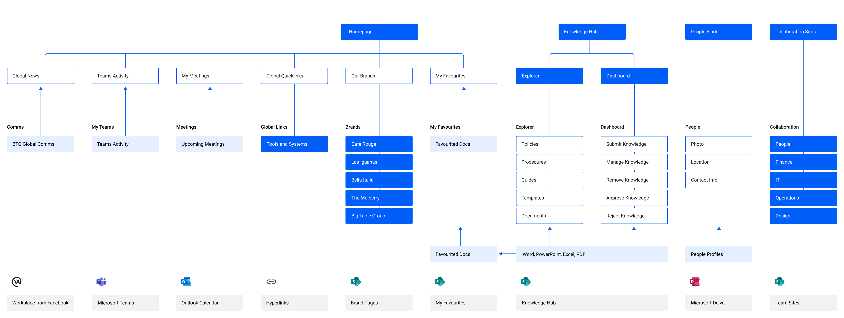
Digital Workspace Release One Structure

Slide 11
Wireframes
Big Table Group

Slide 12
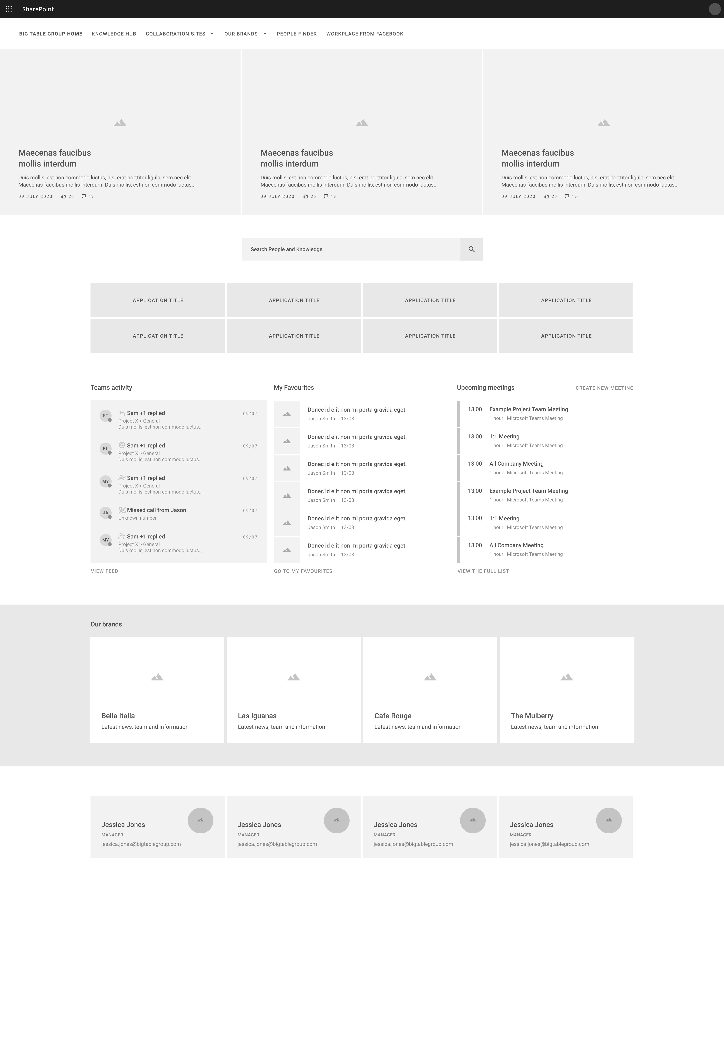
RELEASE ONE
Big Table Group Digital Workspace
One Digital Workspace
The home page for the platform will become the primary entry point to the Big Table Group digital workspace. The home page will provide intuitive and unobstructed access to communications, collaboration and applications, enabling self-service and increased efficiency.
Key components that the user can engage with:
Home Page
Global Newsfeed
Integration with Workplace BTG News Group
Global Quicklinks
Teams Activity Feed
Integration with Teams activity and start new teams chat
BTG People
Latest Searched People
My Favourites
My Calendar
Brand Navigator
Promotion of brand pages

Slide 13
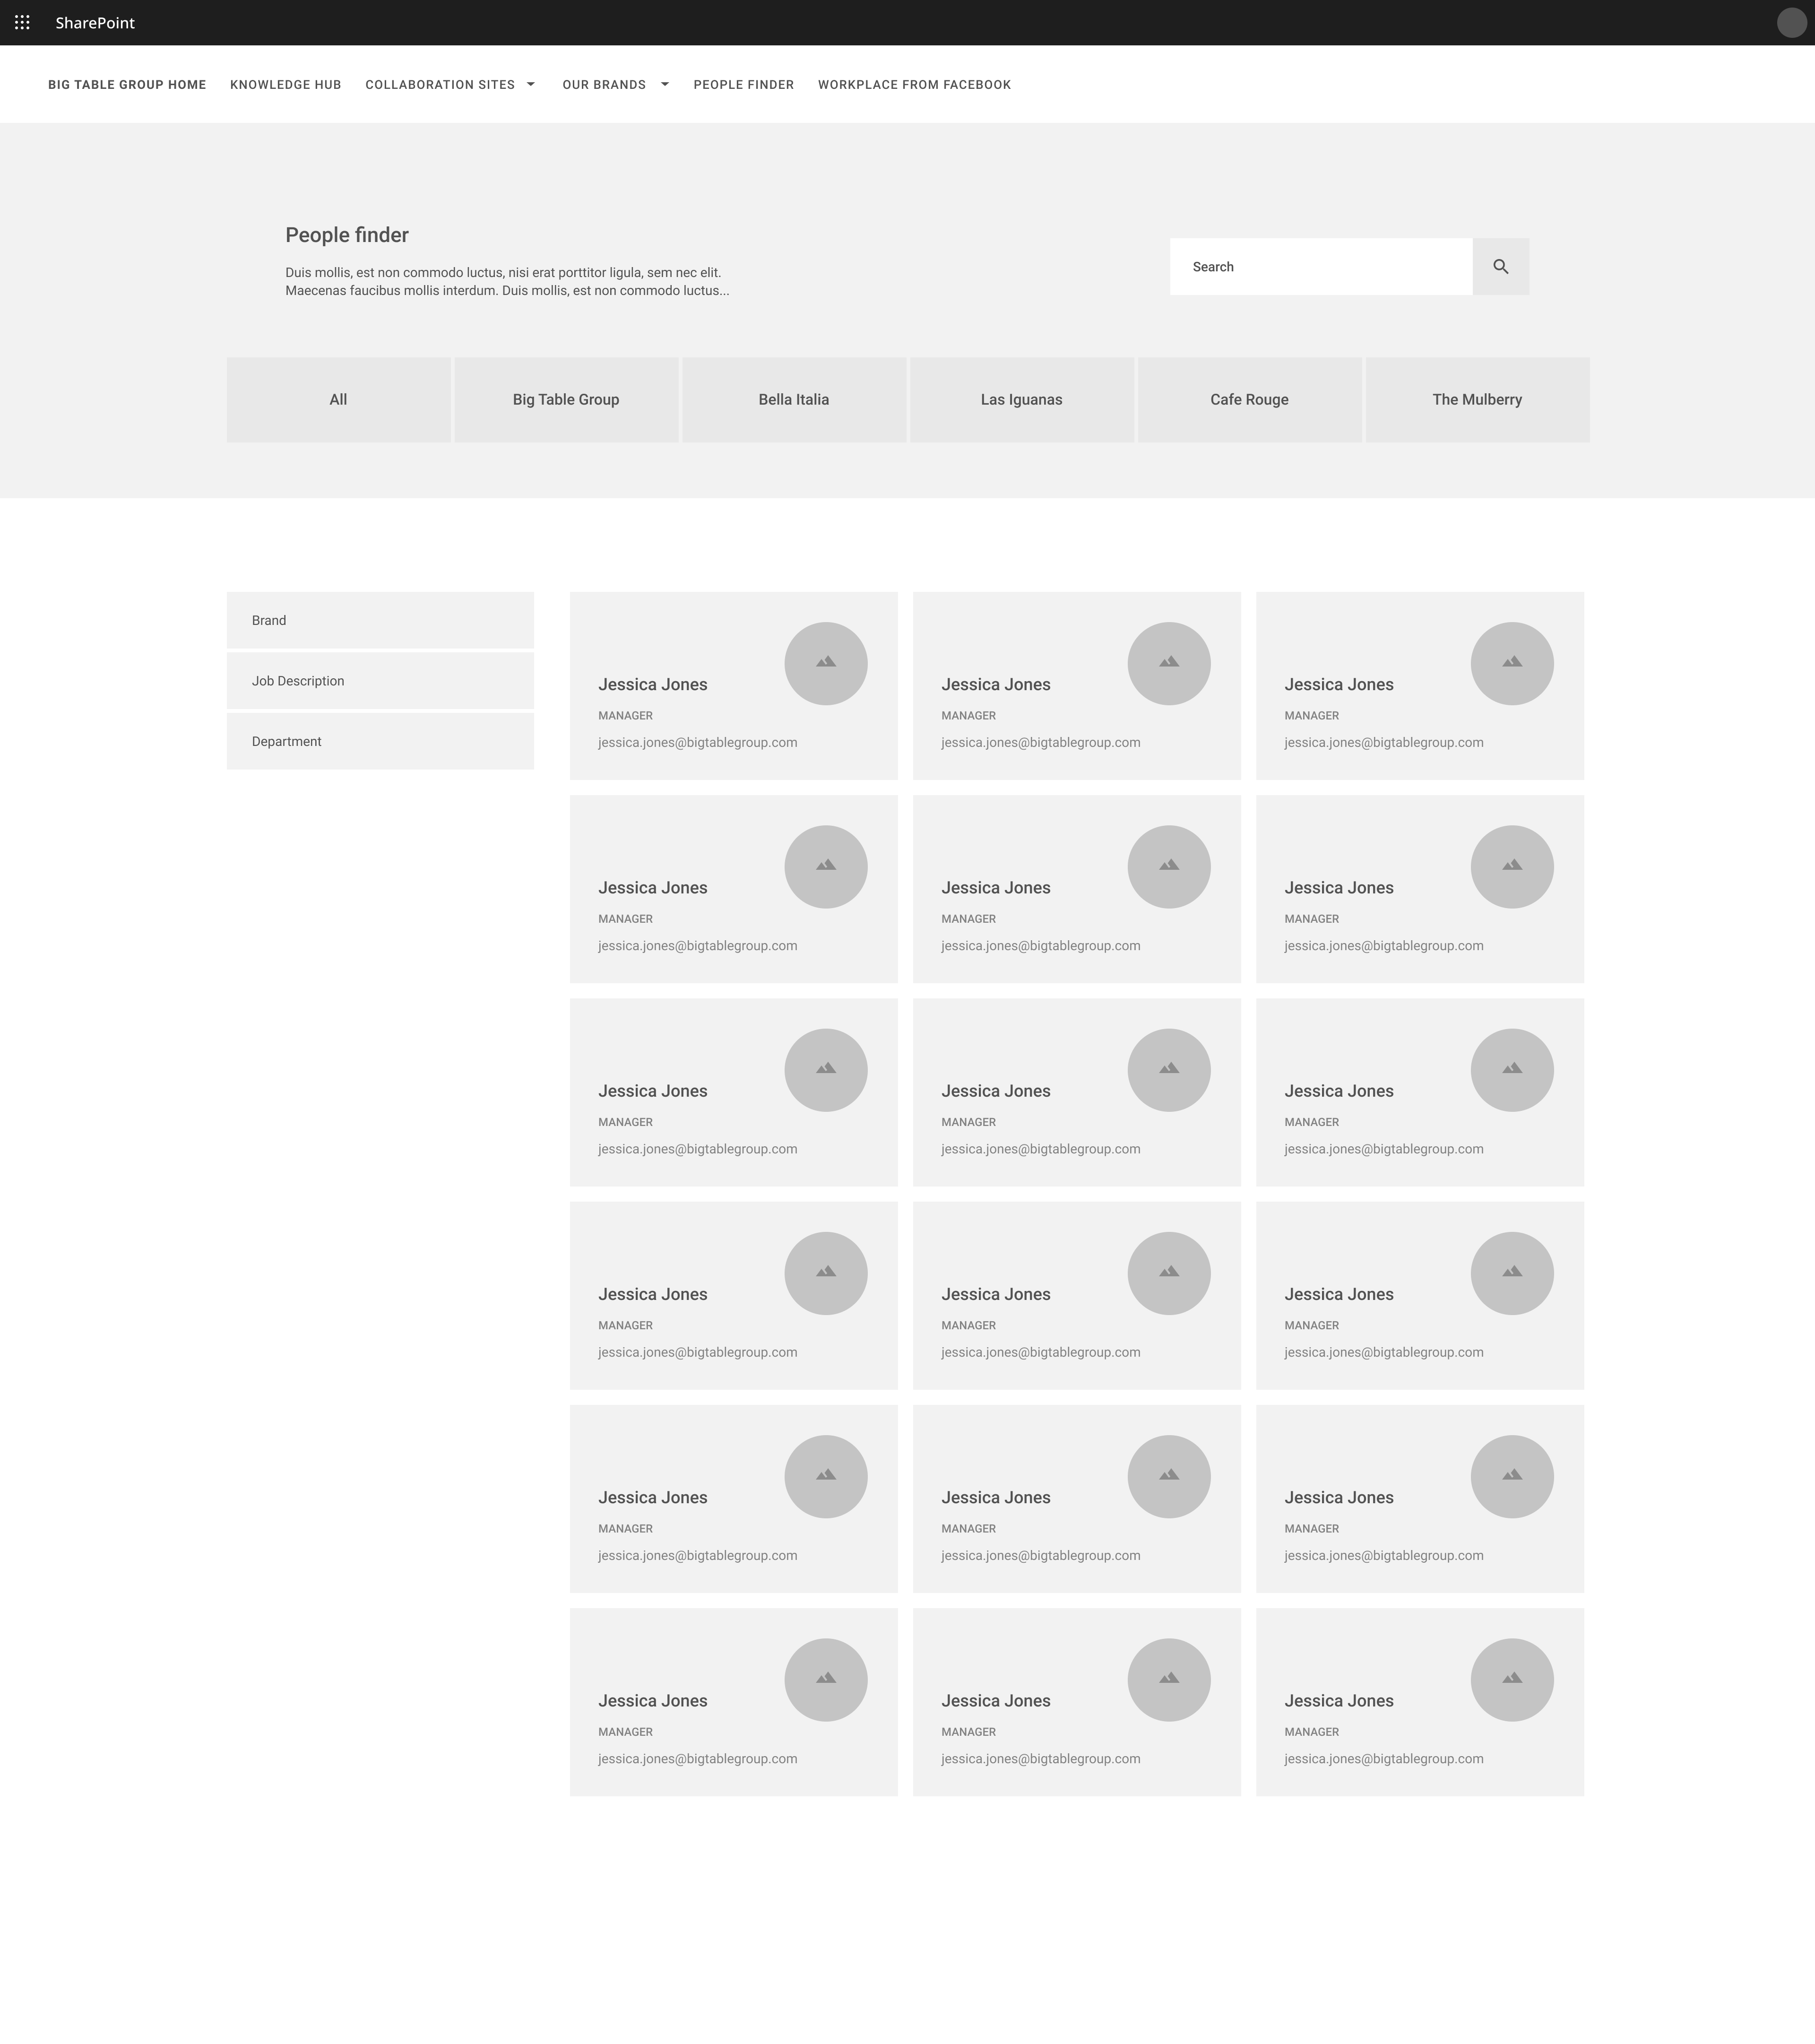
RELEASE ONE
People Finder
One Digital Workspace
The People Finder is the primary way for employees to find Big Table Group people globally.
Users can search and refine to access to people’s profiles and contact details, linked with their Microsoft profiles in Delve.
Key components that the user can engage with:
Global Navigation – Access to all areas of the platform
Search – Ability to search for Big Table Group People
Filters – Users can simply navigate Big Table Group People
People Tiles – Tiles that show profile picture, name, job title
Clicking a tile will display more profile details in a modal window – users can then view the Delve profile in the Delve application.

Slide 14
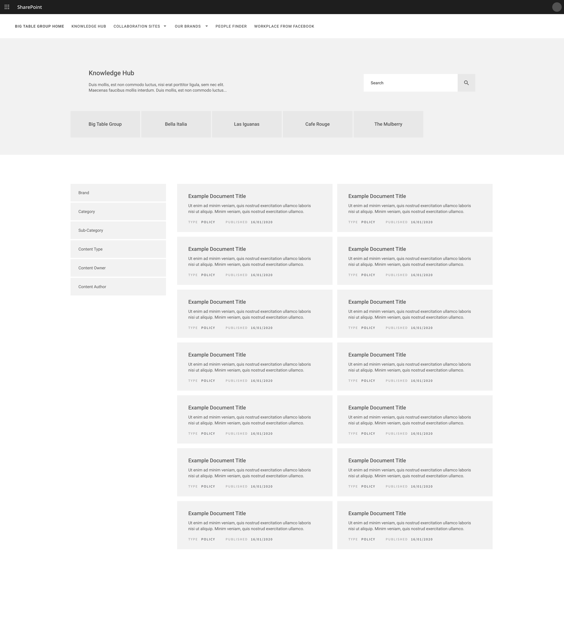
RELEASE ONE
Knowledge Hub
One Digital Workspace
The Knowledge Hub is the primary way for employees to find content they need for their work day, navigating intuitively to find documents and knowledge. The Hub is a controlled library for business knowledge, with all content being subject to approval and review workflows, ensuring all content in the solution is relevant and up-to-date.
The Knowledge Hub provides employees with content that they can trust, knowing that it is a single source of truth.
Content Types:
• Policies
• Procedures
• Forms
• Processes
• Templates

Slide 15
Next steps
Big Table Group

Slide 16
Information needed
Digital Workspace
Next steps
Activities to be completed
BTG agree release one scope, wireframes and release schedule
Azuronaut complete hi-fidelity designs and prototype
Azuronaut submit statement of work
BTG sign-off SoW and hi-fidelity designs
Quicklinks
Need to agree number of links
Are they operational area specific?
Knowledge Hub
Need to know number of documents (estimated)
Need to know number of content types
Policies, Templates, Procedures, Guides
Need to agree navigation structure
Brand (BTG, BI, LI, CR, TM)
Operational Area
Content Type (Policy, Procedure, Template, Guide)
Brand Pages
Need to agree content
Workplace
Need to agree groups to sync with
Notes:
Workplace Personal Feed Viable? Not visual
Workplace Global pulling from multiple groups?
Magazine feeds (budget available?)
Social feeds (budget available?)

Slide 17
IguanaNet Content
Digital Workspace
Global Intranet
Operational Sub-Site
Workplace
Recruitment Templates
People Paperwork – Appraisals, Payroll, Files
People Policies and Procedures
People Training
Forms
People Reports
Setting up for Success & Shift Mgmt
Service & Reservations
Complaint Handling
Allergens
Food Certificates
Ibuy, Ordering & Fresh Direct
Technical Specs
Stock & Order
Marketing & Promotions – Brand Image Gallery Marketing Calendar, Marketing League Tables, Marketing News, Marketing Forms, Merchandising
Training – Bar Training, BOH Mgmt Training, External Training Providers, Floor Training, FOH Mgmt Training, Iguana Bites Kitchen Training, NSO Training
Insurance, Licensing, Maintenance, Contact & Feedback
Ask the Brand Director a question
Give your feedback
Benefits and Incentives
Well-being – Helpline, Eyecare, Uniform Cleaning
Staff Food
NEW Recipe Ideas
Blogs
Latest Scams
Newsletter
Iguana Video Outtakes

