Slide 1
CHS Group
Corporate Intranet – Discovery
NOVEMBER 2019

Slide 2
Problem Statement
CHS Group has up until now, relied upon traditional communication methods such as email, shared folders and word of mouth to share important messages, information and knowledge.
Key issues that exist are:
No clear governance around knowledge management
Duplication of documentation
Inability to effectively search for information and knowledge independently
Loss of documentation, information and knowledge
Silos of information
Reliance on key individuals across the business to locate specific documents.
Outdated intranet solution not being used

Slide 3
Project Objectives
Design and development of a CHS Group Corporate Intranet and Knowledge Management Solution that will provide CHS Group employees unobstructed and seamless access to centralised business knowledge, communications and work systems, enabling self-service and increased efficiency.
Objectives:
Improve internal communication between employees across CHS Group
Improve internal knowledge sharing and collaboration
Provide a central repository and access point for all knowledge, information, tools and applications
This will be the one trusted source of truth for all employees.
Create consistency in the way certain common documents are documented (i.e. policies, procedures, etc.)
Generate efficiencies in the way that CHS Group employees work and reduce duplication of effort.

Slide 4
Project Requirements
A corporate intranet and knowledge management for all non-customer documentation, consisting of:
An intranet portal to help bring everything together into a unified experience for all CHS Group employees.
Key entry point to systems and knowledge, making it easy for CHS Group employees to find everything they need.
A clean and intuitive interface that easy for CHS Group employees to use without obstruction.
The high-level requirements are:
Centralised storage of documentation
Mobile experience accessing and amending documents
Intelligent approach to permissions
Version Control and Workflows
Comprehensive search
Collaborative working

Slide 5
Solution Overview
Based on the high-level requirements from CHS Group, Azuronaut propose using SharePoint, Office 365 and Workplace to drive the desired intranet functionality.
Accessible through modern browsers in desktop and mobile devices
SharePoint to store static intranet content
SharePoint to assign and enforce security
Azure to host APIs required to access authenticated external systems
Azure AD to Authenticate to Azure APIs
Modern browser client technologies to create the navigation interface
SharePoint to search
Google Analytics to capture usage of Intranet

Slide 6
User Personas – Intranet and Knowledge Base
Desk-Based Employees | Desk-Less Employees | KB Content Owners | KB Content Authors | Administrators
183 Users | 306 Users | 36 Users | 92 Users | 5 Users
13 - Senior Mgmt Group (SMG) | 37 - Nursery | 13 - Senior Mgmt Group (SMG) | 13 - Senior Mgmt Group (SMG) | 05 - ICT
23 - Managers | 191 - Carer | 23 - Managers | 23 - Managers
22 - Service Managers | 20 - Cook |  | 39 - Administrators
39 - Administrators | 58 - Housekeeping |  | 05 - ICT
05 - ICT |  |  | 12 - Finance
12 - Finance
11 - Housing Officer (HO)
03 - Surveyors
08 - Advisor
43 - Support Worker
04 - Night Concierge

Slide 7
Biography
Current tools/process
They spend their time ensuring the smooth running of their department / service. Reacting to issues that arise and planning ahead to future service developments. They work closely with their colleagues to ensure effective customer service.
G Drive; Outlook; Excel; CHSnet; Workplace.
Great Plains for Invoices;
Charity Log and QL for customer and property data.
OPS Managers – Nourish
Nursery Managers and Admin - Famly
Jane
Doe
Goals and motivators
Key needs
CHS GROUP
Business readiness and alignment. Keeping stakeholders engaged, aware and happy. Providing excellent customer service.
Clarity on where to find and store documents
Reliable/trusted/valid data tools and templates.
Area for regularly used documents
Quick links to software or sites that are used as part of their job
PERSONA
Desk-Based Employee
BUSINESS ROLES
Ideal experience
Manager; Officer; Adviser; Administrator; Finance; Surveyor; Support Workers
A smooth and intuitive experience that increases their workday efficiency and effectiveness. Information that is accurate and consistent. All tools in one place.
Frustrations
Working with data stored in multiple places. Inconsistent approach to handling and storing information. Cross department communication.
AGE RANGE
ARCHETYPE
Behaviors
Day-to-day power user
A substantial part of their time is spend at their desk populating spreadsheets; responding to emails; writing letters; writing reports; taking minutes. Officers, Advisers, Support Workers and Surveyors are customer facing and spend much of their time visiting, speaking over the phone, handling customer and property data using QL or Charity Log.
PROFICIENCY
Professional desktop user, Smartphone user

Slide 8
Biography
Current tools/process
Working in our Older People Service and Nurseries, the desk-less employee spend their day building relationship with service users and their family; identifying special needs; planning and supporting daily activities, ensuring that our service users are cared for, that all legislative regulation is adhered to and that the environment is safe and clean
Paper folders and print outs
G Drive; Excel; Workplace (low uptake)
Some Carers will use Nourish App via Tablet
Nursery Staff will use Famly App via Tablet
Ralph
Greene
Key needs
CHS GROUP
Quick and easy access to info they need to do their job. Reliable/trusted/up to date policies and procedures.
PERSONA
Goals and motivators
Desk-Less Employee
Excellent customer care and safeguarding
BUSINESS ROLES
Nursery Staff; OPS Carer; Cook; Housekeeping
Ideal experience
Frustrations
Able to use the knowledge hub to find information that they may need.
Feeling more connected to CHS.
Not having easy access to corporate policies
Isolated, not feeling part of the company; not having the same access to information as other staff.
Broken links; old versions of documents.
AGE RANGE
ARCHETYPE
Behaviors
Occasional user
Physically demanding job – most of their time with customer or providing services for the customer.
PROFICIENCY
Tablet User; Smartphone User

Slide 9
Biography
Current tools/process
Overseeing and managing all functions in a specific area or department. Plans and implements department strategies and also takes part in the company’s overall strategic decisions and ensures that their allotted department(s) are working in accordance with such goals
G Drive; Outlook; Excel; CHSnet; Workplace.
Great Plain; Board Vantage
Douglas
Webb
Key needs
CHS GROUP
Goals and motivators
All content is up to date and easily accessible to staff. Simple, structured policy review process.
PERSONA
Responsible for all aspects of the company’s success. Report to board members, committees and other CHS stakeholders. They strive to uphold CHS values, meet fiscal targets and manage company budgets.
Content Owner
BUSINESS ROLES
Directors; Heads of Service
Ideal experience
Frustrations
A smooth and intuitive experience that increases workday efficiency and effectiveness.
Getting and keeping leaders and stakeholders engaged.
AGE RANGE
ARCHETYPE
Behaviors
Day-to-day power user
Preparing and overseeing writing of papers for board and committees. Chairing and attending meetings Strategy Development. Networking. Line-management.
PROFICIENCY
Professional desktop user, Smartphone user

Slide 10
Biography
Current tools/process
Content Authors work on creating and maintaining accurate information for use across the business. Some content will also be shared with customers on our website
Outlook; Excel; Word;; Publisher; PowerPoint; QL Reports; G Drive; CHSnet; Board Vantage.
Donna
Munoz
Goals and motivators
Key needs
CHS GROUP
Keeping stakeholders engaged, aware and happy
All content is up to date and easily accessible to staff. Simple, structured policy review process
Reliable/trusted/valid data.
Tools and templates to capture data
PERSONA
Content Author
BUSINESS ROLES
Heads of Service; Managers; Some Administrators
Ideal experience
Frustrations
A smooth and intuitive experience that increases their workday efficiency and effectiveness. Information that is accurate and consistent. All tools in one place.
Working with data stored in multiple places. Inconsistent approach to handling and storing information. Cross department communication.
Lost information and having to rewrite content.
AGE RANGE
ARCHETYPE
Day-to-day power user
Behaviors
PROFICIENCY
A substantial part of their time is spend at their desk populating spreadsheets; responding to emails; writing letters; writing reports; taking minutes. Content Authors rely on up to date, accurate data in order to present content.
Professional desktop user, Smartphone user

Slide 11
Biography
Current tools/process
Responsible for the upkeep, configuration, and reliable operation of computer systems; especially multi-user computers, such as servers.
Service Desk; AD self-service portals.
Abs Vanat
Goals and motivators
Key needs
CHS GROUP
Ensure that the uptime, performance, resources, and security of the computers they manage meet the needs of the users
Improved file structure and versioning control​
Simple file restore. Auditability. Security.​
Wiki where we can publish articles / videos / FAQs that users can follow.
PERSONA
Administrator
BUSINESS ROLES
ICT
Ideal experience
Frustrations
Ability to create workflows to make the UX better when communicating with ICT.
File share – unnecessary amounts of data due to duplication and poor use.​
Having to restore user deleted files
AGE RANGE
ARCHETYPE
Behaviors
Day-to-day power user
Dealing with user issues. Monitoring systems. Planning for the future.
PROFICIENCY
Super User

Slide 12
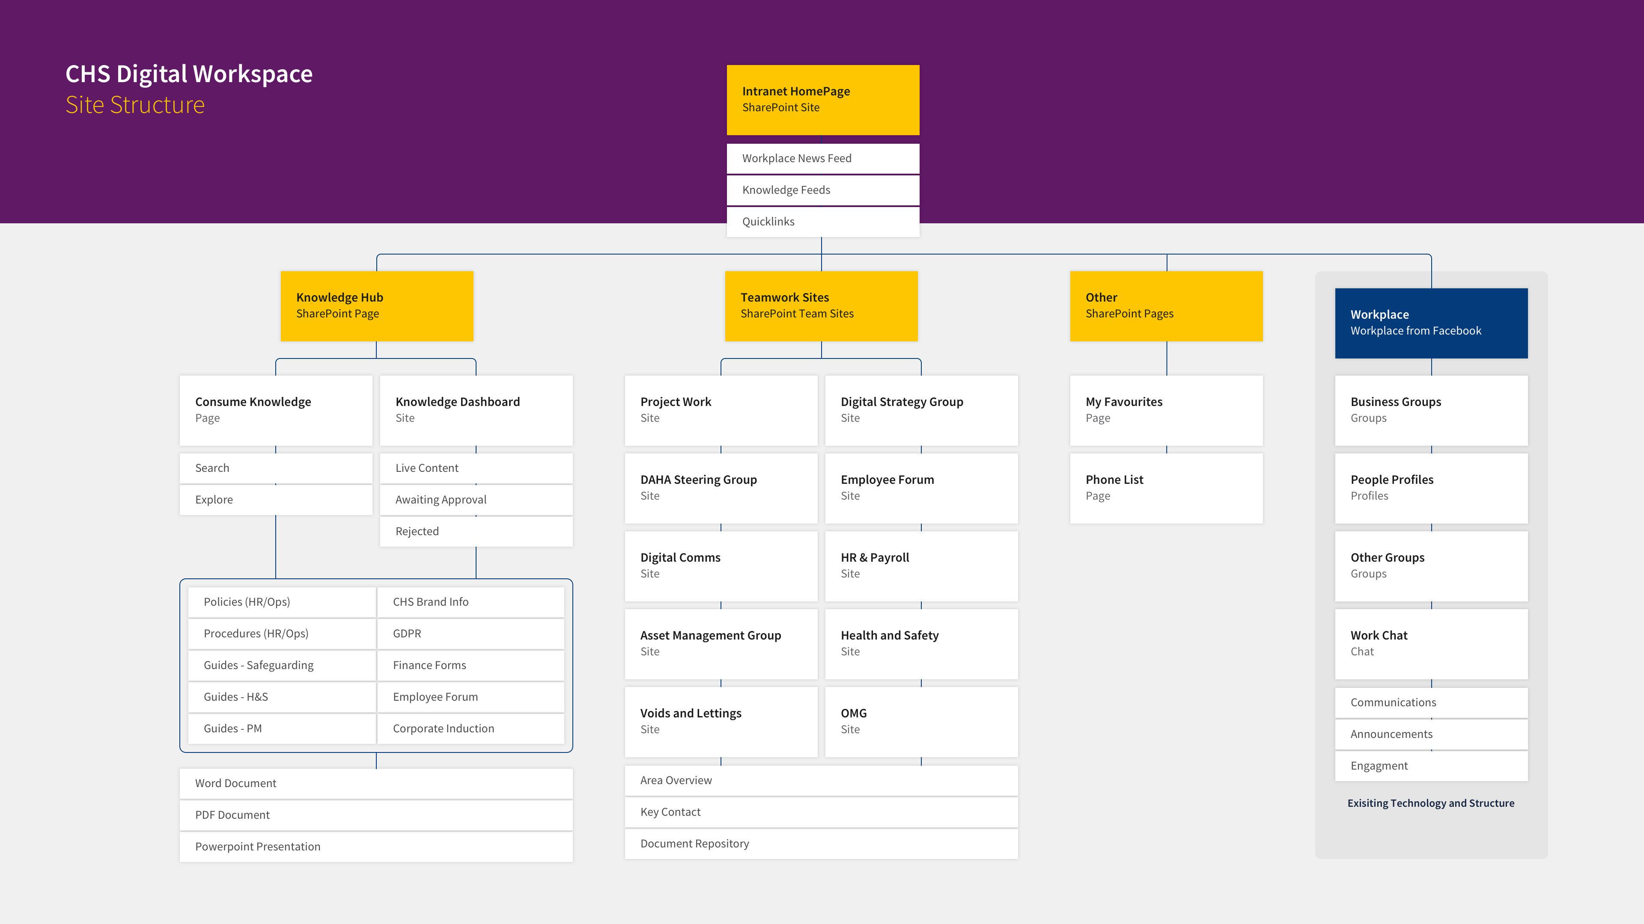
Site Structure
Collaboration Sites
Knowledge Base
Intranet HomePage
Workplace
Policies
Procedures
Working Instructions
Tools and Templates
Processes
News
Comms
Business Area Based Secure Sites
Working Documents

Slide 13
Intranet
Corporate level entry point that serves as central first point of call for users to access all CHS Group content.
The key components that the user can engage with are:
Header navigation drop down links to individual team sites
Search feature
Central news feed featuring four news articles (WP)
New and updated content feeds
Quicklinks
QL, Cascade, Great Plains, Charity Log, Famly, Board Vantage, PanConnect Can this be personalized – so only QL users see the QL link etc.?
Primary links to tools and sites:
Collaboration Sites
Workplace by Facebook
Knowledge Management System

Slide 14
Knowledge Base
The ‘Knowledge Hub’ is a dedicated navigator for users to intuitively find the content they need by allowing them to refine all content stored in the solution quickly and easily.
The key components that the user can engage with are:
Browse Knowledge Types
Search
Featured Knowledge
Latest Additions
Quicklinks

Slide 15
Knowledge Base – Content Types
CONTENT TYPE | CREATE/UPLOAD | UPDATE | ARCHIVE | VIEW/DOWNLOAD/PRINT
Policies – HR and Operations | Content Owners and Authors Only | Content Owners and Authors Only | Content Owners only | All employees
Procedures – HR and Operations | Content Owners and Authors Only | Content Owners and Authors Only | Content Owners only | All employees
Guides – Safeguarding – Health and Safety – Project Management | Content Owners and Authors Only | Content Owners and Authors Only | Content Owners only | All employees
CHS Brand Information | Content Owners and Authors Only | Content Owners and Authors Only | Content Owners only | All employees
GDPR | Content Owners and Authors Only | Content Owners and Authors Only | Content Owners only | All employees
Finance Forms | Content Owners and Authors Only | Content Owners and Authors Only | Content Owners only | All employees
Employee Forum | Content Owners and Authors Only | Content Owners and Authors Only | Content Owners only | All employees
Corporate Induction | Content Owners and Authors Only | Content Owners and Authors Only | Content Owners only | All employees

Slide 16
Collaboration Sites
Collaboration Sites are areas of the intranet where different teams store working documentation and come together to collaborate.
Each collaboration site will have the same look and feel, containing information about the business area. The sites will be restricted to individuals that are granted permission to view and edit.
Each area landing page will contain:
An introductory blurb to the business area
Key contact details for the Head of the Business Area
Quick Links Widget
A Document Repository

Slide 17
Collaboration Sites
SITE | DEFINITION | ACCESS
Project Work | We need somewhere for current project documentation to live. There may numerous different projects running at once with different cross department project teams. | All /access will depend on the project?
Digital Strategy Group | Digital Strategy Group | SMG; ICT; Business Change Manager
DAHA Steering Group | Domestic Abuse | ALL
Employee Forum | Employee Forum | Employee Forum Reps
Digital Comms | Website; Social Media; Customer Portal | Various named staff
HR & Payroll | Documentation around pay | HR & Finance
Asset Management Group | Asset Management Group | Various named staff - could this be SMG??
Health and Safety | Hackett Review; Risk Assessments; Solo protect | ALL
Voids and Lettings | Admin around letting properties | Housing Services; Property Services; Customer Services; OMG
OMG | Operational Management Group | SMG; Managers; Service Managers
SITE | SITE
Business Change
Chief Executive SMG
Data Protection
Business Intelligence
Health and Safety
Human Resources
ICT
Finance
Customer Services
Property Services
Housing Services
Community Investment
Supported Housing
Older People Services
Operations | 25

Slide 18
Operational Areas
AREA
Customer Services
Property Services
Housing Services
Older People Services
Community Investment
Supported Housing
Finance
GDPR
HR
ICT
C&CD

Slide 19
Approval Workflow
Policies and Procedures
A user must be able to see the Owning Operational Area when selecting a content type.
The Content Owner of the appropriate Operational Area must be notified via email when a piece of content has been submitted to the Knowledge Hub.
The Content Owner must be able to Approve or Reject the content before the content is visible within the Hub:
If Approved – the Author will receive a notification email that the submitted content has been approved and is now live on the Hub
If Rejected – the Author will receive a notification email that the submitted content has been Rejected with an attached note from the Owner explaining why.
AUTHOR
Submit Content Form
Select: Policy or Procedure
Select: Operational Area
Input: Content Title and Description
Upload: Document
Submit content for Approval
Author Notified
Approved
Owner Approval
Operational Area Designated Persons
Author Notified
Rejected
OWNER
Approved?
No
Approval for Submission Rejected
Owner Provides
Reason for Rejection
Yes
Submission Approved
Visible on Knowledge Hub

Slide 20
Review Workflow
The Content Owner of the appropriate Operational Area must be notified via email six months prior to the end of the three-year review cycle that a piece of content is up for review.
KNOWLEDGE HUB
Policy or Procedure
30 months after approval to Knowledge Hub
Owner Notification
Operational Area Designated Persons
Content Tagged in KH as ‘In Review’
Whilst in review
OWNER
Approved?
No
Approval for Submission Rejected
Owner Updates Content and Re-Submits
Yes
Submission Approved
Visible on Knowledge Hub

Slide 21
Prototype
Homepage
Primary Header Navigator
Hero Banner – Knowledge Search, Link to Knowledge Hub, Collaboration Sites, Workplace
Workplace Newsfeed
Workplace Groups (SP Admin Controlled)
Quicklinks (existing tools and systems)
My Favourites
Recently Updated/New (Knowledge Feed)
Knowledge Hub
Primary Header Navigator
Hero Banner – Knowledge Search, Quick Explore Refiners, Link to My Favourites
Content Results
Content Filters
Approval Workflows (Content Author/Owners)
Review Workflows (12 month content reviews)
Favouriting Feature
Modal Window to view content overview before download/view document
My Favourites
Primary Header Navigator
Hero Banner – Title
Content Results
Ability to unfavourite
Collaboration Sites
Primary Header Navigator
Out of the box Team Sites
Permission by existing AD groups

Slide 22
User Feedback on Current Intranet
Document Folders
G Drive Structure is too confusing
Multiple folders in different places
No clear rules on how to store documents
Everyone being able to create folders
New folders being added without checking whether an appropriate place already exists
No naming protocols
Too much choice
No clear responsibility
No guidelines on Desktop and H Drive use
Retention – difficult to delete/ archive old docs as in so many places
Retention – too many old documents not archived
Version Control – Staff using old versions of forms
Photo Library – images not titled
CHSnet (our current SharePoint offering)
Have to download and save before sending a document
Broken links
Who is responsible?
Looks out of date so assume old info
Not everyone uses it
Clunky
Outlook
Not naming scanned documents before emailing
Many staff use Outlook as a filing system as it is easier to keep tidy and can be filtered, sorted and searched more easily
Workplace
Not all staff use it

Slide 23
Org Structure
Chief Executive Team
C&CD Development
HR & ICT
Finance
Operations Directorate
Customer Services
Property Services
Housing Services
Business Intelligence
Older People Services
Community Investment
Supported Housing
Young People Services
Russell Street
Corona House
Sunflower Nurseries
Money Matters
Care Homes
Extra Care
Sheltered Housing
Finance
Data Protection
HR
ICT

